Slide 1
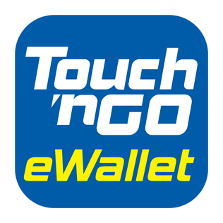

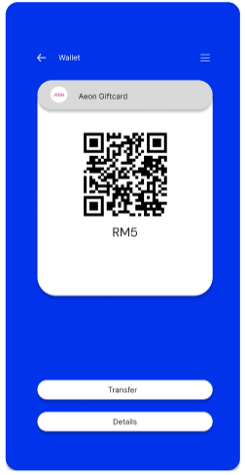
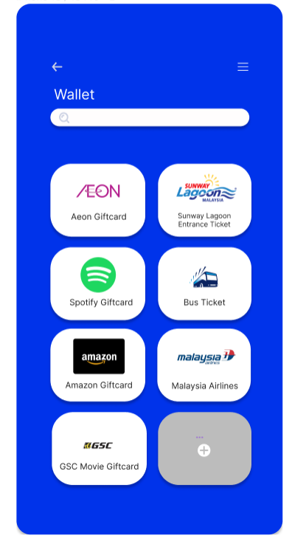
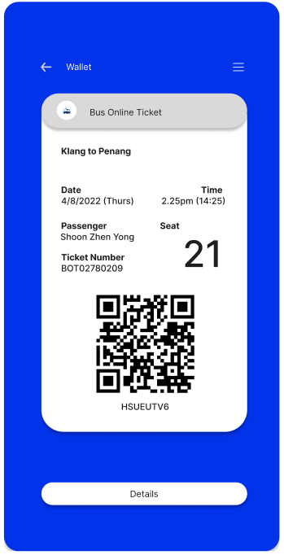
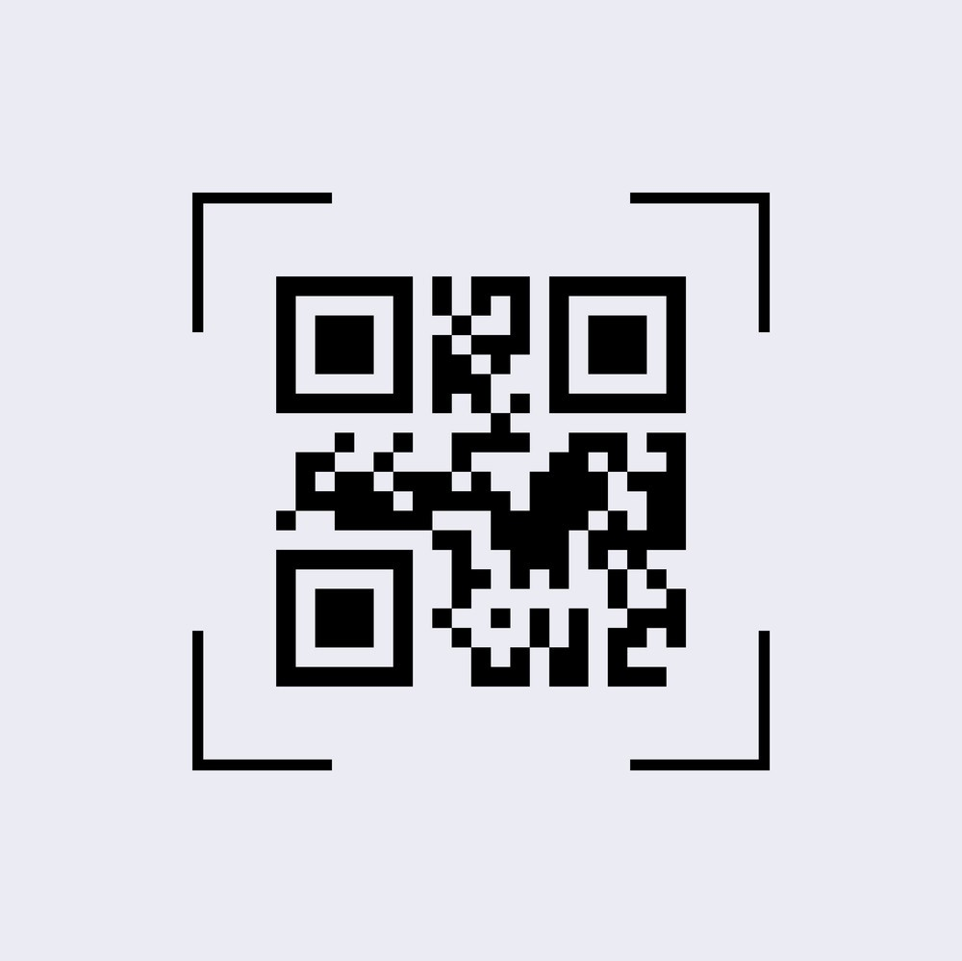

Passes
2
Save it into your eWallet
1
Scan the QR Code/ Barcode of the passes OR click on the icon
OR
3
View the details of the passes

Slide 2
Problem Statement
User finds it challenging to store or fully utilize all the pasess such as physical/digital vouchers, tickets and physical membership cards as it may be problematic in terms of storage, security and usability. This would drive low participation rate in the business loyalty programme.

Slide 3
Market / Consumer Needs
Virtual Pass Holder
Pass Issuer
01
02
Store the pass’s information securely and access all of them with a single mobile application
Place or platform where businesses could issue loyalty passes, tickets or vouchers to customer

Slide 4
Value Proposition
Gain creators
Send vouchers to friends as gift cards
Peer-to-peer pass sharing
Carry all the passes only with your mobile phone
Never carry physical passes anymore
Gains
Redeem the voucher
Use the passes by showing the QR Code at the payment gateway or entrance.
Products & services
Fast and convenient
Job-To-Be-Done
Store and access passes in the TNG E-Wallet.
Type of Pass supported:
Ticket
Loyalty Card
Voucher
Gift card
Easy access to passes
Participate in the business loyalty programme with the membership card
Theft & Fraud
Business issue the loyalty pass or virtual voucher to customer
Carrying a lot of passes when shopping
Losing your passes
Show ticket at entrance checkpoint
Store and manage passes digitally
Pains
Passes don’t read properly
TNG PIN to secure the pass information
Passes will get damaged or blurred after a long period of time
Claim the purchased ticket and store it into TNG e wallet
Low participation of customer to use physical voucher/ membership card
Pain relievers

Slide 5
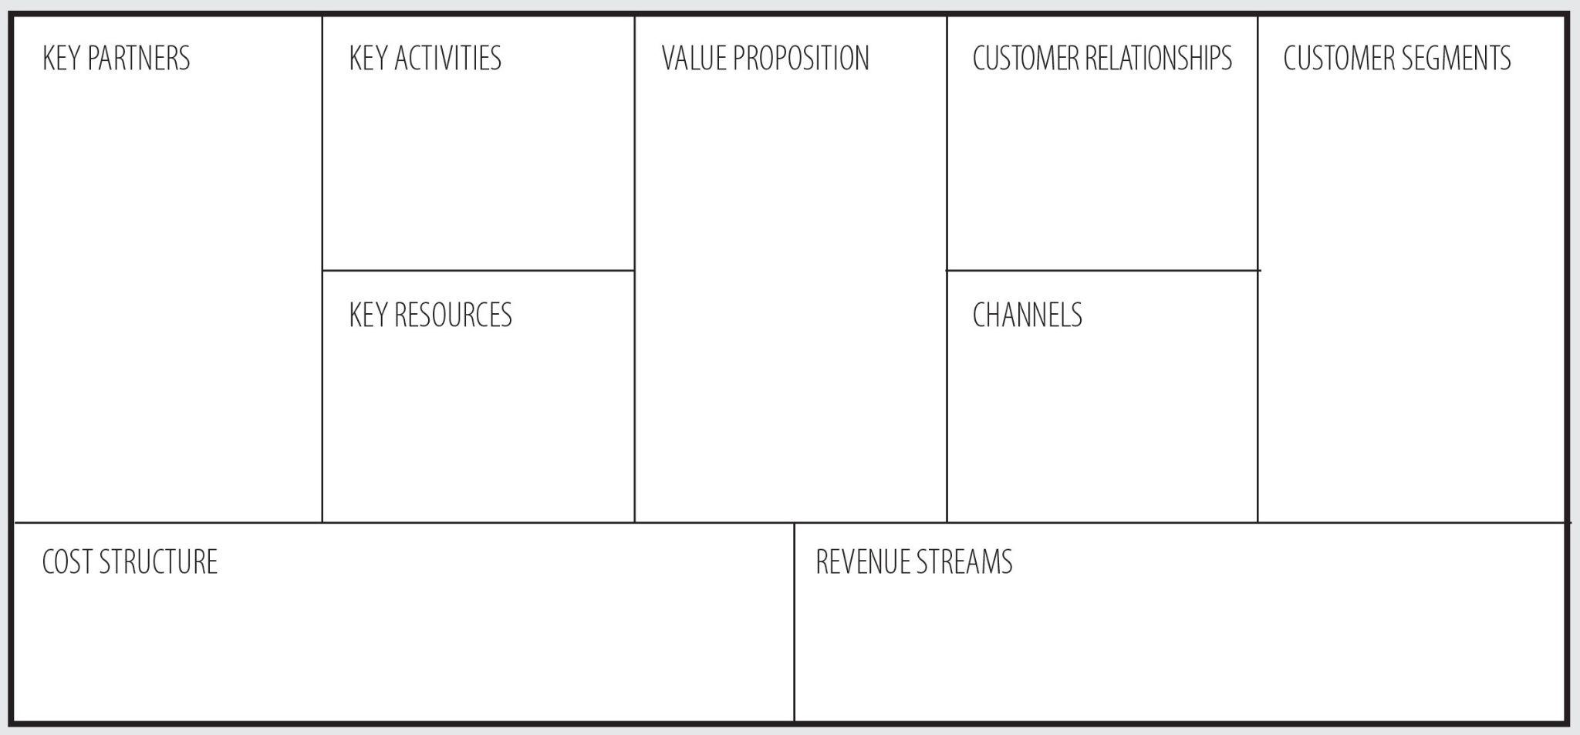
Business Model
Platform Development and Maintenance
Store and access digital passes within the TNG e-wallet
Peer to peer
Business that issue passes like ticket,voucher and loyalty card
Software Developer
Marketing and customer acquisition
Digital Passes
Business (pass issuer)
Customer Support
Protect the pass information
Peer to peer pass sharing
Consumer
TNG E-Wallet platform
TNG e-wallet app
TNG E-Wallet ‘s existing users
Payment terminal and Barcode scanner at entrance checkpoint
TNG brand name
Platform Development and Maintenance
Human Resources
Fees (platform and merchant fee )
Opportunity in Integrations with loyalty programs and promotion from other business
Server infrastructure
Marketing
Attract more users

Slide 6
Closing Remarks
It’s always a hassle to bring many passes with you when shopping or travelling. Thus, this is an excellent idea to digitalise passes and add them in the TNG e-wallet like how we store our physical passes in our wallet. It would be a fast and convenient approach for users to store, access and share their passes with a single device. It would not only make e-wallet a more enjoyable application, but also an indispensable daily essential.

